Slide 1
Cooperative estimation
2+ agents w/ egocentric & relative measurements
Applications:
Multi-agent SLAM
“Intent” estimation

Slide 2

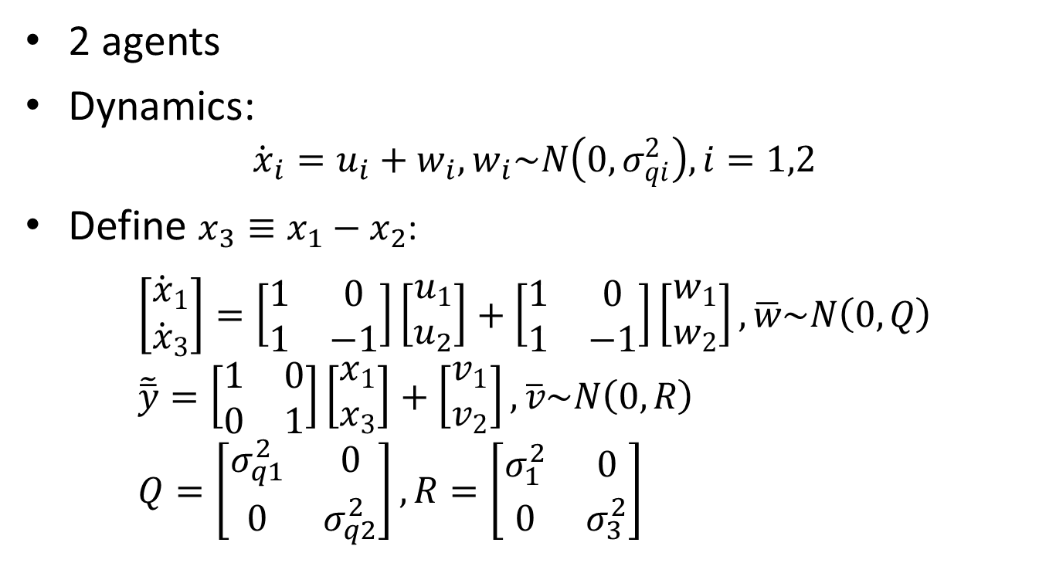


1-D example
$$x_{1}$$
2 agents
Dynamics:
$${\dot{x}}_{i}=u_{i}+w_{i},w_{i}\sim N\left(0,σ_{qi}^{2}\right), i=1,2$$
Define $x_{3}≡x_{1}−x_{2}$:
$$\left[\begin{aligned}{\dot{x}}_{1} \\ {\dot{x}}_{3}\end{aligned}\right]=\left[\begin{matrix}1 & 0 \\ 1 & −1\end{matrix}\right]\left[\begin{aligned}u_{1} \\ u_{2}\end{aligned}\right]+\left[\begin{matrix}1 & 0 \\ 1 & −1\end{matrix}\right]\left[\begin{aligned}w_{1} \\ w_{2}\end{aligned}\right],\overline{w}\sim N\left(0,Q\right) \\ \tilde{\overline{y}}=\left[\begin{matrix}1 & 0 \\ 0 & 1\end{matrix}\right]\left[\begin{aligned}x_{1} \\ x_{3}\end{aligned}\right]+\left[\begin{aligned}v_{1} \\ v_{2}\end{aligned}\right],\overline{v}\sim N\left(0,R\right) \\ Q=\left[\begin{matrix}σ_{q1}^{2} & 0 \\ 0 & σ_{q2}^{2}\end{matrix}\right],R=\left[\begin{matrix}σ_{1}^{2} & 0 \\ 0 & σ_{3}^{2}\end{matrix}\right]$$
$$x_{3}$$
$$x_{2}$$

Slide 3
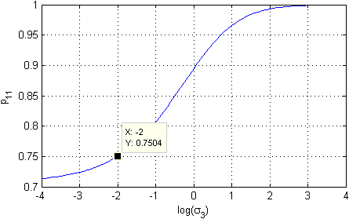
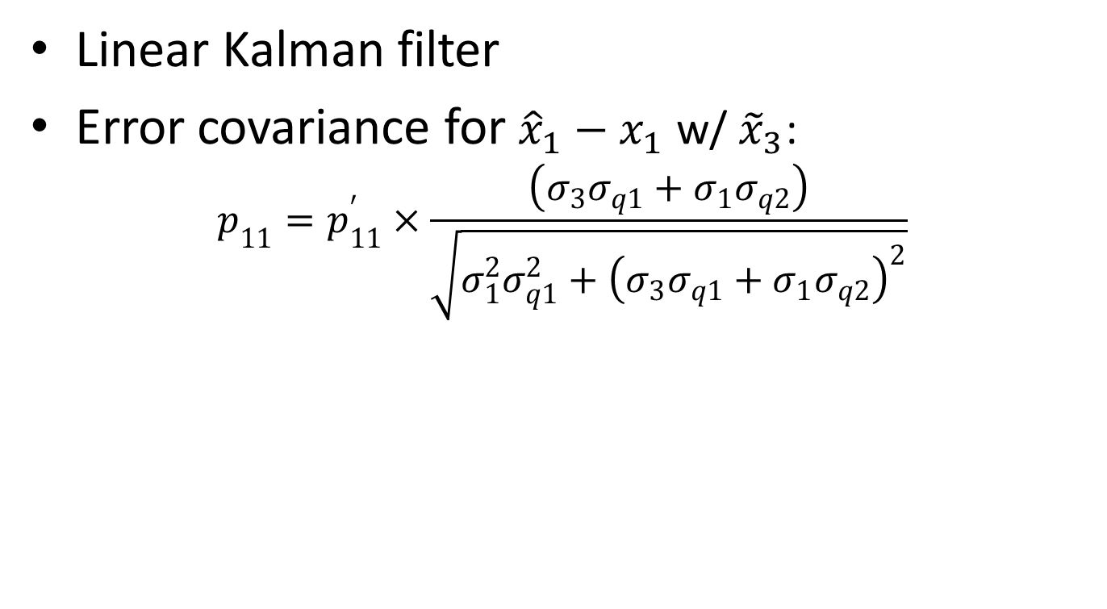

Steady-state expectation
Linear Kalman filter
Error covariance for ${\hat{x}}_{1}−x_{1}$ w/ ${\tilde{x}}_{3}$:
$$p_{11}=p_{11}^{′}×\frac{\left(σ_{3}σ_{q1}+σ_{1}σ_{q2}\right)}{\sqrt{σ_{1}^{2}σ_{q1}^{2}+{\left(σ_{3}σ_{q1}+σ_{1}σ_{q2}\right)}^{2}}}$$
$$g_{1}=g_{2}=1,σ_{1}=1,σ_{q1}=1,σ_{q3}=1$$

Slide 4


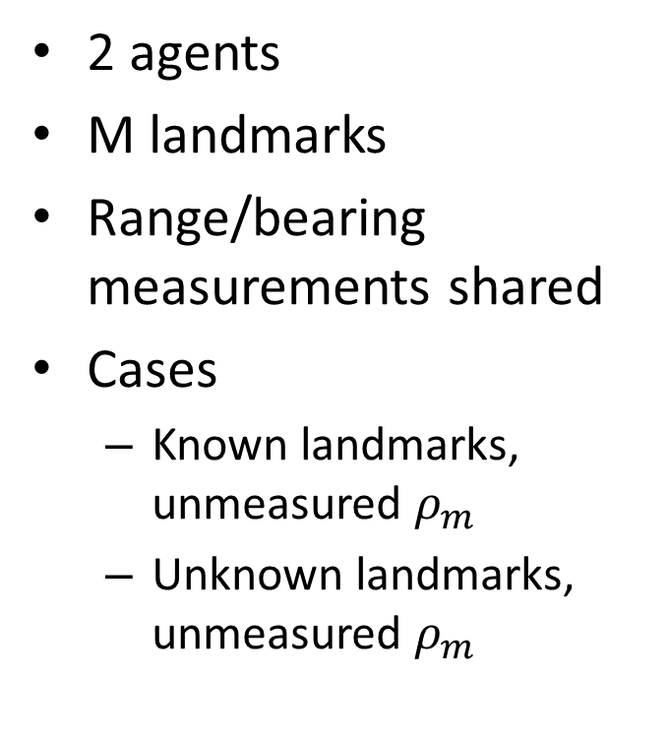



Characteristic problem
2 agents
M landmarks
Range/bearing measurements shared
Cases
Known landmarks, unmeasured $ρ_{m}$
Unknown landmarks, unmeasured $ρ_{m}$
$$m$$
$$ρ_{m},θ_{m}$$
$$i$$
$$ρ_{ik},θ_{ik}$$
$$k$$

Slide 5
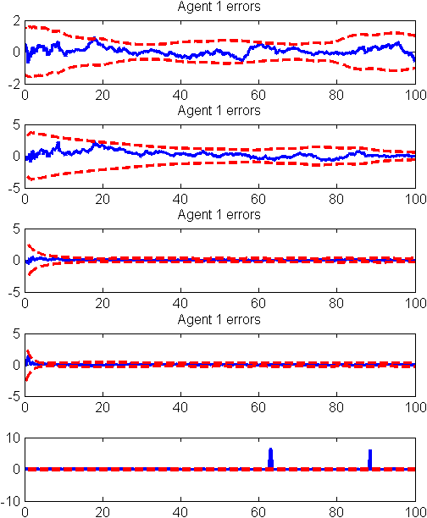
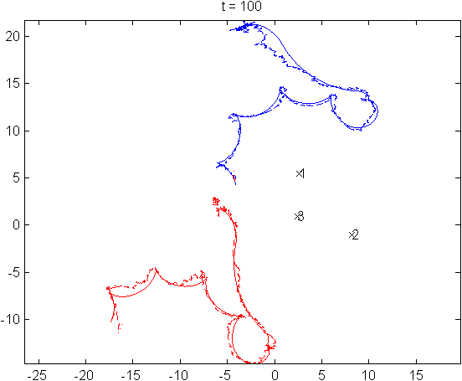
Preliminary results

Slide 6
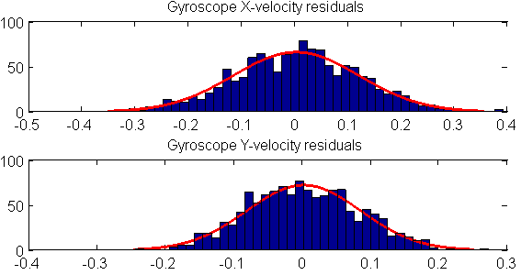
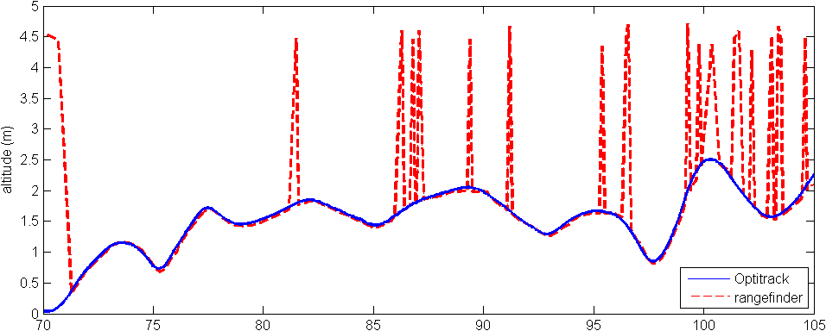
Group work
AR.drone drag characterization
System ID from Optitrack
IMU and optic flow sensor characterization
Ultrasonic range altitude measurements

